Slide 1
CLIMATE KNOWLEDGE EXTRACTION USING DATA MINING
AN IPCC CHAPTER CASE STUDY
BIODIVERSITY LAB, NIPGR, NEW DELHI
By
Gayathri jonnalagadda (191FA14025)
4TH BI
Department of Biotechnology
VFSTR

Slide 2

TEXT AND DATA MINING
WHY ARE WE DOING THIS?
All the information that can literally save the world is locked away in PDF’s (IPCC reports)
PDF versions are neither human friendly nor machine friendly.
All this data is simplified into a structured knowledge that can be helpful to various sectors of young researchers, educationalists, etc. to use and apply them in their field of work.

Slide 3
IPCC REPORTS
IPCC - The Intergovernmental Panel on Climate Change
The Intergovernmental Panel on Climate Change (IPCC) is the United Nations body for assessing the science related to climate change.
IPCC is established in the year 1988.
First IPCC assessment report is published in the year 1990

Slide 4
IPCC PRINCIPLES
The IPCC has adopted its rules of procedure in the "Principles Governing IPCC Work". These state that the IPCC will assess
The risk of climate change caused by human activities,
Its potential impacts, and
possible options for prevention.

Slide 5
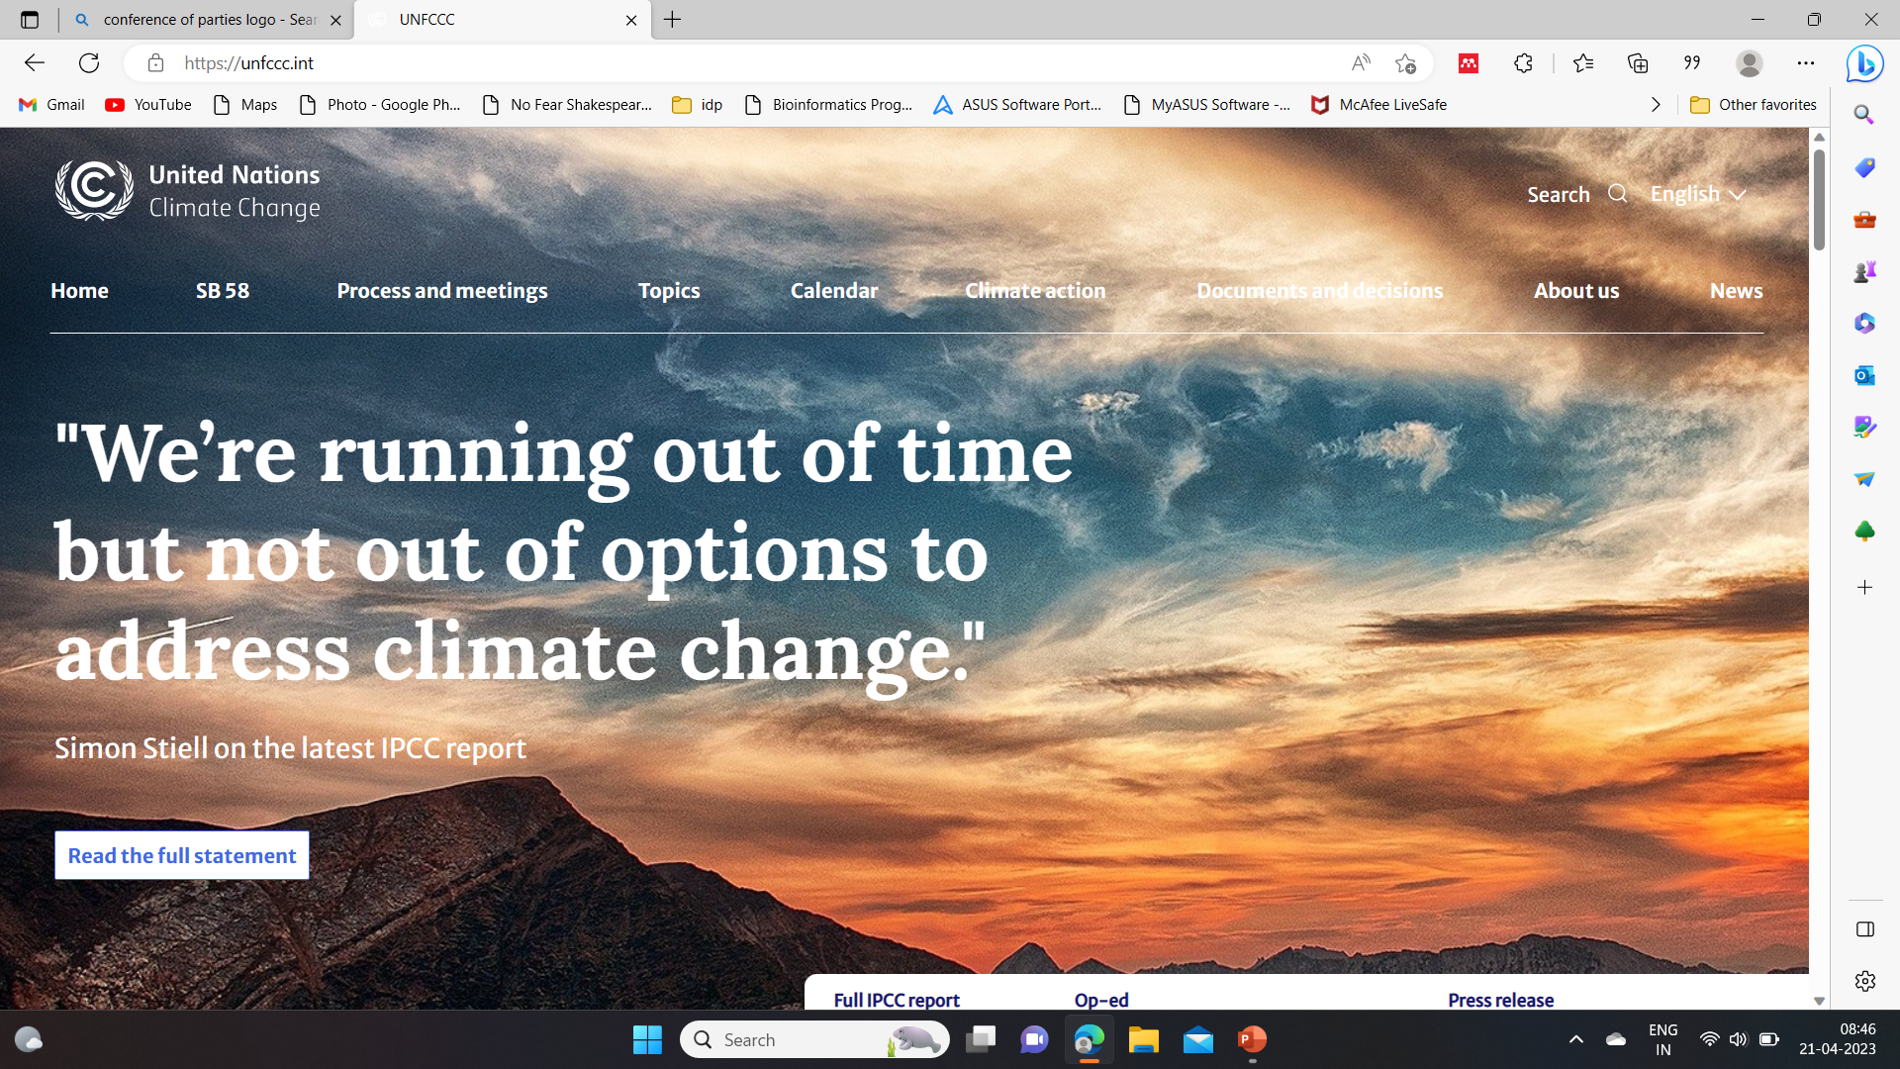
FINANCE AND INVESTMENT
UNFCCC – COP 15 (2009) mobilizing USD 100 billion by developed countries to developing countries.
First mention of finance and investment as a chapter is in AR5,WG3 IPCC reports(2014).
Conference of Parties (COP)21 – 2015 Paris Agreement.
Second mention of finance as an individual chapter is in IPCC AR6 WG3(2022).
Data from IPCC -AR5-EG3-CH16

Slide 6

PARIS AGREEMENT
Produced long-term goals to countries:
Holding the increase in the global average temperature to well below 2°C
Increasing the ability to adapt to the adverse impacts of climate change and foster climate resilience
Making finance flows consistent with a pathway towards low greenhouse gas emissions and climate-resilient development.

Slide 7
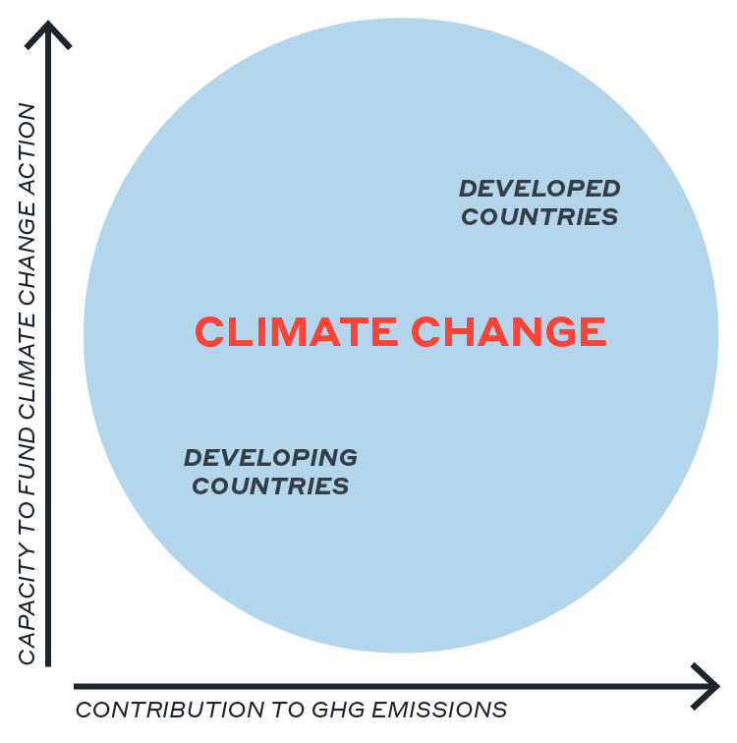
KEYNOTE FROM THE IPCC CHAPTER
Chapter 15: “Finance and Investment” (AR6, WG3)
Why finance climate action? A LIVABLE CLIMATE IS BEST INVESTMENT
Information on this slide is from ipcc chapter_15_finance_and_investment

Slide 8
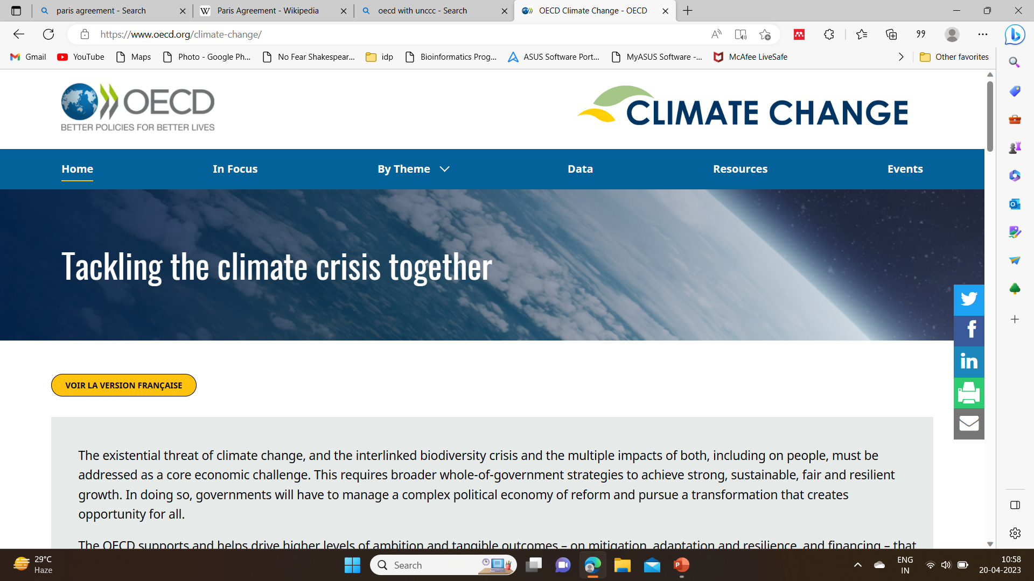

OECD & UNFCCC

Slide 9
LIST OF DEVELOPED AND DEVELOPING COUNTRIES
DEVELOPED | COUNTRIES
Australia | European Union | Latvia | Portugal
Austria | Finland | Liechtenstein | Romania
Belgium | France | Lithuania | Slovak Republic
Bulgaria | Germany | Luxembourg | Slovenia
Canada | Greece | Malta | Spain
Croatia | Hungary | Monaco | Sweden
Cyprus | Iceland | Netherlands | Switzerland
Czech | Ireland | New Zealands | United Kingdom
Denmark | Italy | Norway | United States
Estonia | Japan | Poland
Data from OECD and UNCCC

Slide 10
REGION | DEVELOPING COUNTRIES
Africa | Algeria, Angola, Benin, Botswana, Burkina Faso, Burundi, Cabo Verde, Cameroon, Central African Republic, Chad, Comoros, Congo, Côte d’Ivoire, the Democratic Republic of the Congo, Djibouti, Equatorial Guinea, Egypt, Eritrea, Eswatini, Ethiopia, Gabon, Gambia, Ghana, Guinea, Guinea-Bissau, Kenya, Lesotho, Liberia, Libya, Madagascar, Malawi, Mali, Mauritania, Mauritius, Morocco, Mozambique, Namibia, Niger, Nigeria, Rwanda, Saint Helena, Sao Tome and Principe, Senegal, Seychelles, Sierra Leone, Somalia, South Africa, South Sudan, Sudan, Tanzania, Togo, Tunisia, Uganda, Zambia, Zimbabwe
Asia | Afghanistan, Armenia, Azerbaijan, Bahrain, Bangladesh, Bhutan, Brunei Darussalam, Cambodia, China, Democratic People’s Republic of Korea, Georgia, India, Indonesia, Iran, Iraq, Israel, Jordan, Kazakhstan, Korea, Kuwait, Kyrgyzstan, Lao People’s Democratic Republic, Lebanon, Malaysia, Maldives, Mongolia, Myanmar, Nepal, Oman, Pakistan, Philippines, Qatar, Saudi Arabia, Singapore, Sri Lanka, Syrian Arab Republic, Tajikistan, Thailand, Timor-Leste, Turkey, Turkmenistan, United Arab Emirates, Uzbekistan, Viet Nam, West Bank and Gaza Strip, Yemen
Europe | Albania, Andorra, Belarus, Bosnia and Herzegovina, Kosovo, Moldova, Montenegro, North Macedonia, San Marino, Serbia, Ukraine
Americas | Antigua and Barbuda, Argentina, Bahamas, Barbados, Belize, Bolivia, Brazil, Chile, Colombia, Costa Rica, Cuba, Dominica, Dominican Republic, Ecuador, El Salvador, Grenada, Guatemala, Guyana, Haiti, Honduras, Jamaica, Mexico, Montserrat, Nicaragua, Panama, Paraguay, Peru, Saint Kitts and Nevis, Saint Lucia, Saint Vincent and the Grenadines, Suriname, Trinidad and Tobago, Uruguay, Venezuela
Oceania | Cook Islands, Fiji, Kiribati, Marshall Islands, Micronesia, Nauru, Niue, Palau, Papua New Guinea, Samoa, Solomon Islands, Tokelau, Tonga, Tuvalu, Vanuatu, Wallis and Futuna

Slide 11





ARCHITECTURE OF CLIMATE FINANCE FLOW
BILATERAL
Public and private finance
DEVELOPED COUNTRIES
MULTILATERAL
DEVELOPING COUNTRIES
Data from OECD

Slide 12
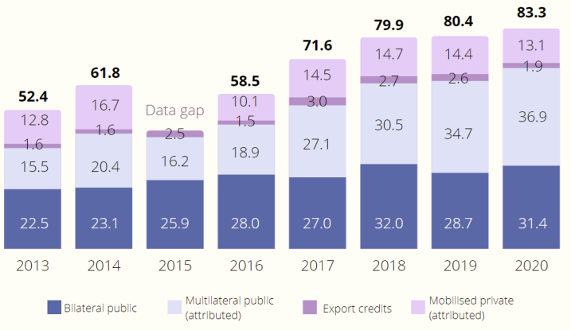
CLIMATE FINANCE PROVIDED AND MOBILISED IN 2013- 2020
Data gap in the year 2015, due to change in measurement methods, making it difficult to compare 2013-14 data with 2016-2020 data.

Slide 13
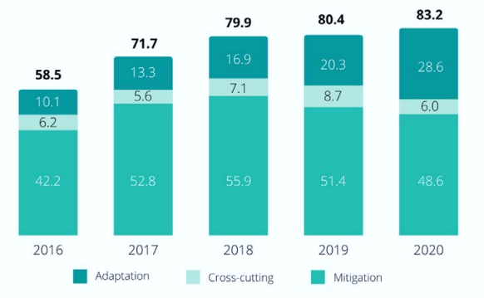
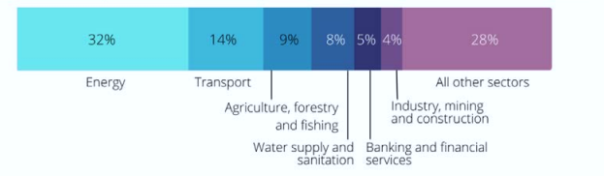
THEMATIC SPLIT OF CLIMATE FINANCE PROVIDED AND MOBILIZED (USD BILLION) 2016-2020
SECTORAL SPLIT OF CLIMATE FINANCE PROVIDED AND MOBILIZED(%) 2016-2020

Slide 14
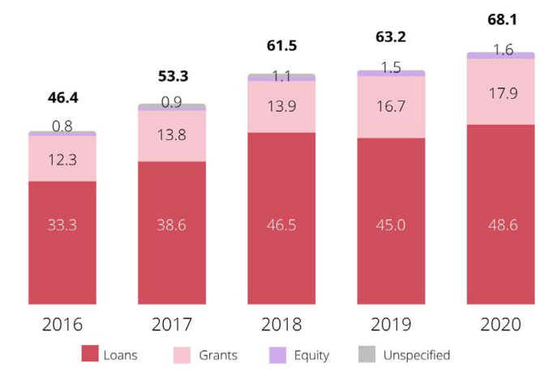
Instrument split of public climate finance in 2016-2020 (USD billion)
Public finance providers mobilize private finance through different types of mechanisms

Slide 15
CLIMATE RELATED DEVELOPMENT FINANCE INDIA 2012-2020
Data from OECD library

Slide 16
SECTORAL SPLIT 2012-2020 INDIA
FINANCE IN USD THOUSAND
Data from OECD library

Slide 17
FINANCIAL INSTRUMENT SPLIT:INDIA 2012-2020
Data from OECD library

Slide 18
ADAPTATION AND MITIGATION SPLIT: INDIA 2012-2020
Data from OECD library

Slide 19
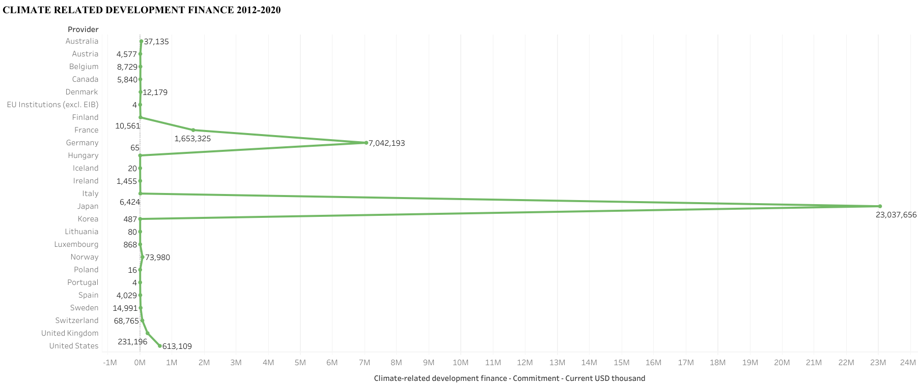
DATA ANALYSIS & VISUALIZATION USING TABLEAU
Germany
Japan

Slide 20
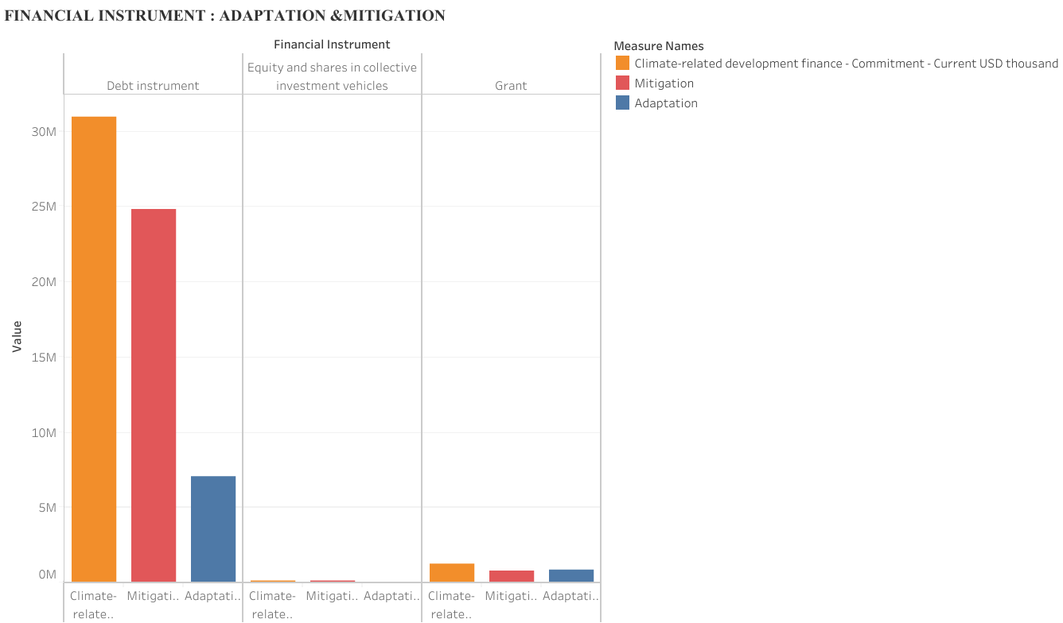
DATA ANALYSIS & VISUALIZATION USING TABLEAU cont..

Slide 21
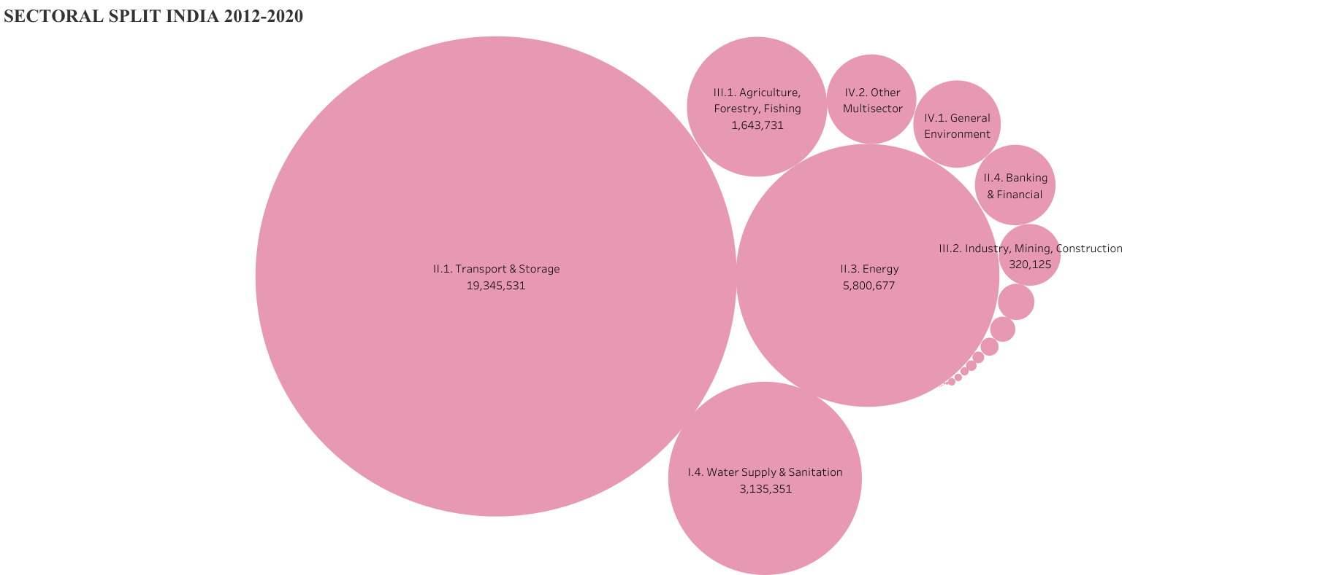
DATA ANALYSIS & VISUALIZATIONUSING TABLEAU cont..

Slide 22
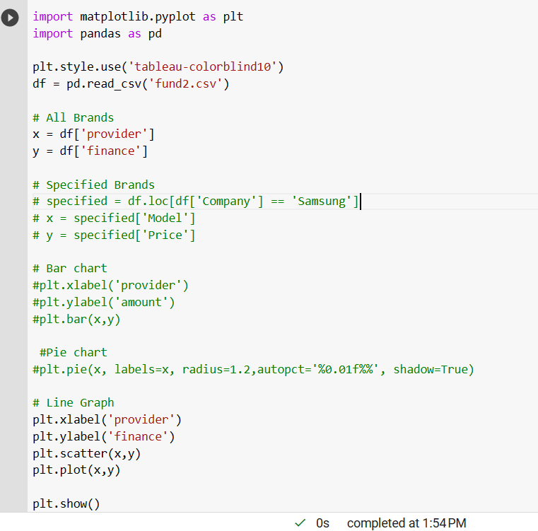
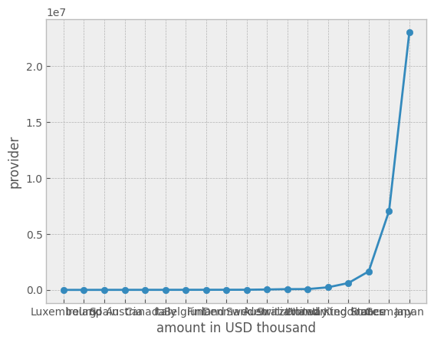
DATA ANALYSIS &VISUALIZATION USING PYTHON
Provider- total finance graph
Google colab – python code

Slide 23
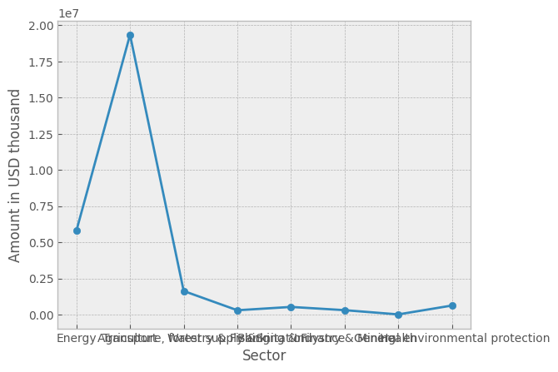
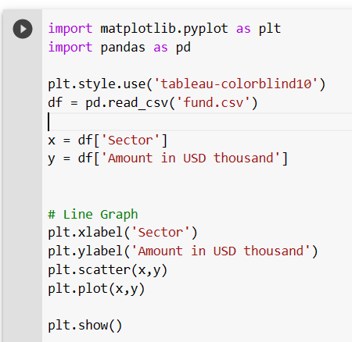
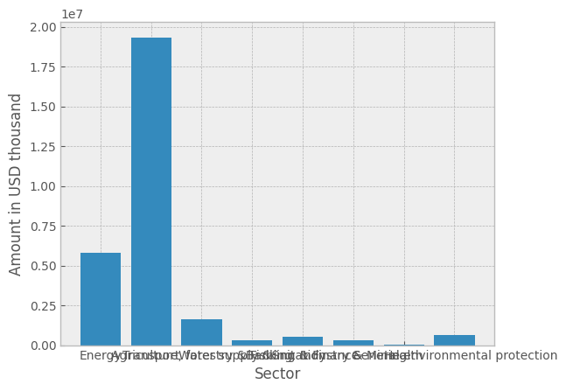
DATA ANALYSIS & VISUALIZATION USING PYTHON cont..
Sectoral split
Google colab – python code

Slide 24
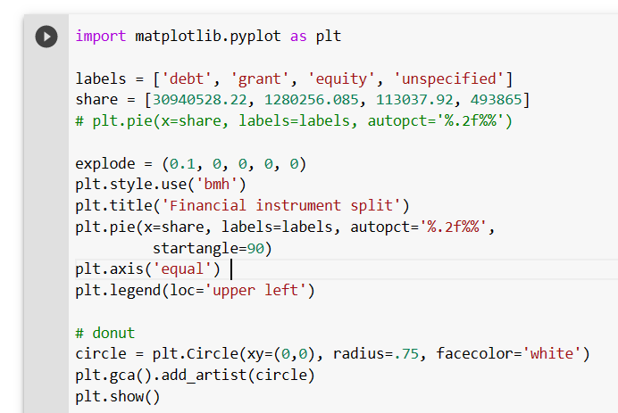
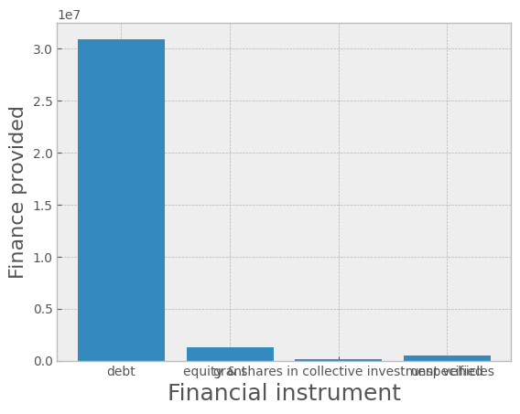
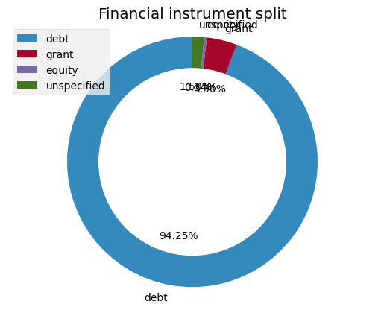
DATA ANALYSIS & VISUALIZATION USING PYTHON cont..
Financial instrument split
Google colab – python code

Slide 25
SUSTAINABLE LIVING GOALS- INDIA
Sector specific (according to the analysis)
Transport , energy – low carbon investments, green transportation, clean energy.
Agriculture, forestry &fishing – major adaptation goals ( key traits: draught and pest tolerance)
Water supply & sanitation- stable water supply and effective water sanitation for all people by the year 2030.
Banking & finance – green funding

Slide 26
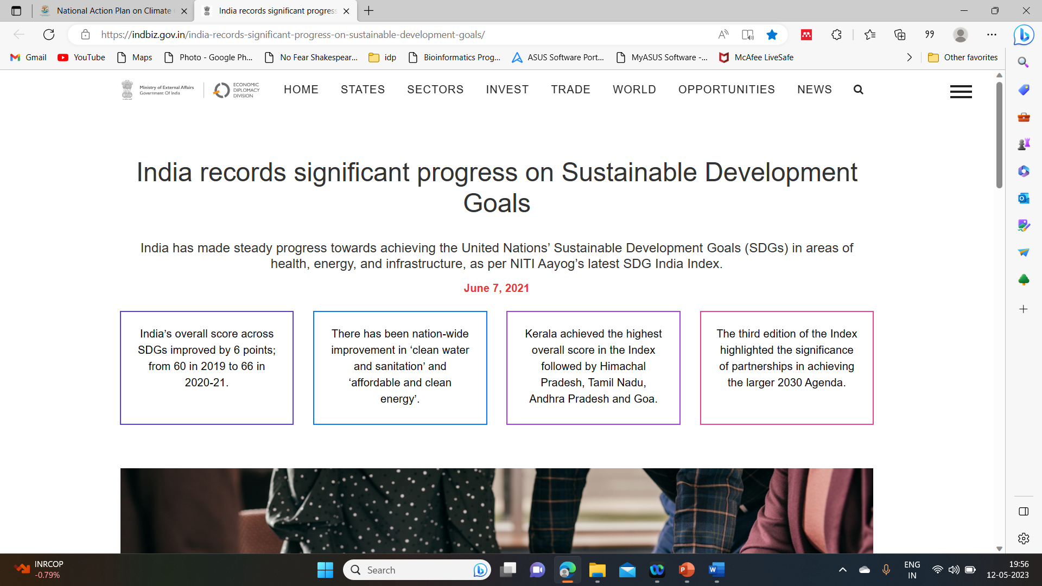

India’s move on sustainable development goals
India records significant progress on Sustainable Development Goals - IndBiz | Economic Diplomacy Division | IndBiz | Economic Diplomacy Division

Slide 27
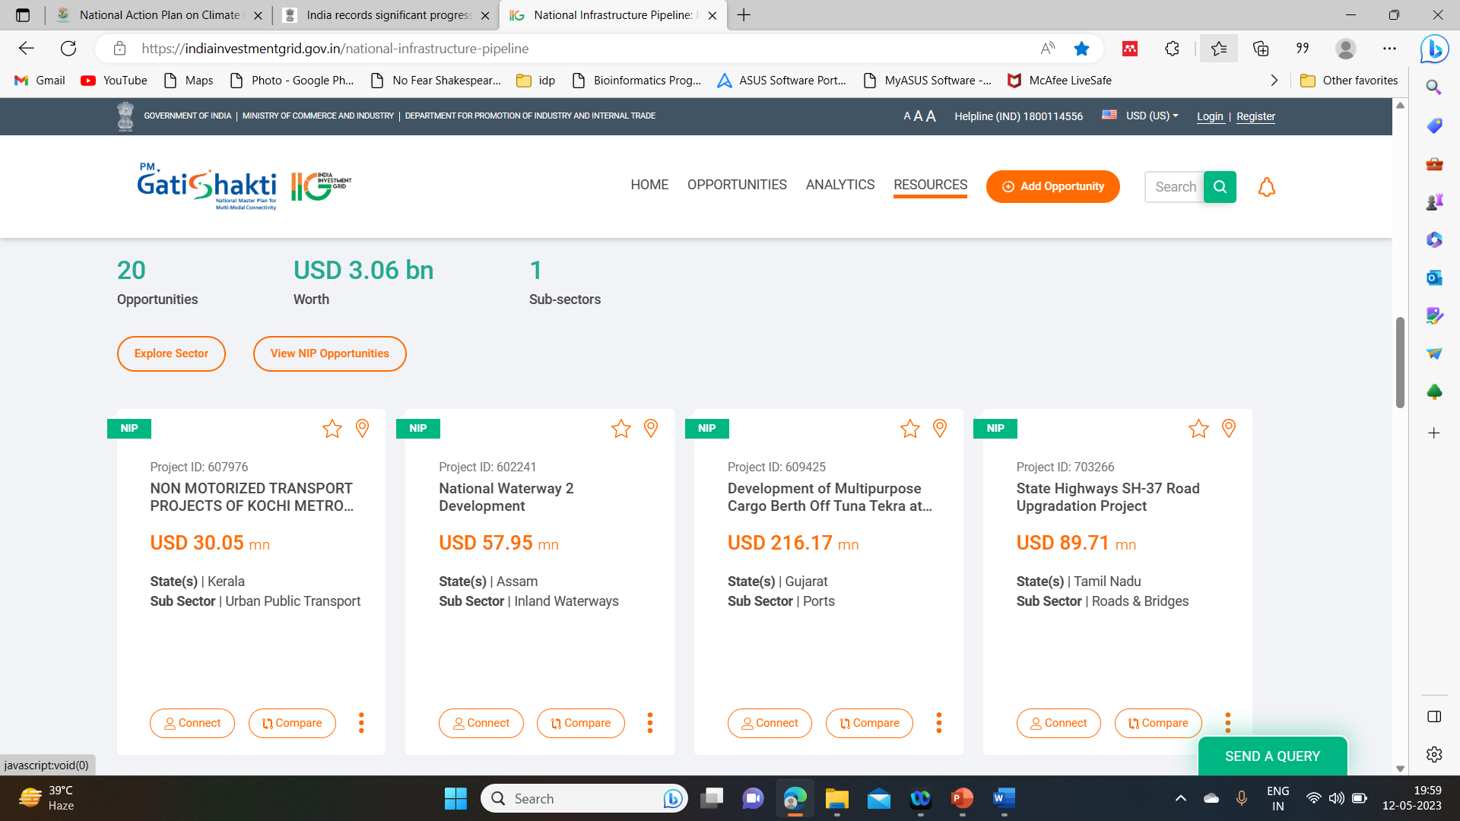
Finance mobilization: India
National Infrastructure Pipeline: Invest in Infrastructure Projects in India | IIG (indiainvestmentgrid.gov.in)

Slide 28
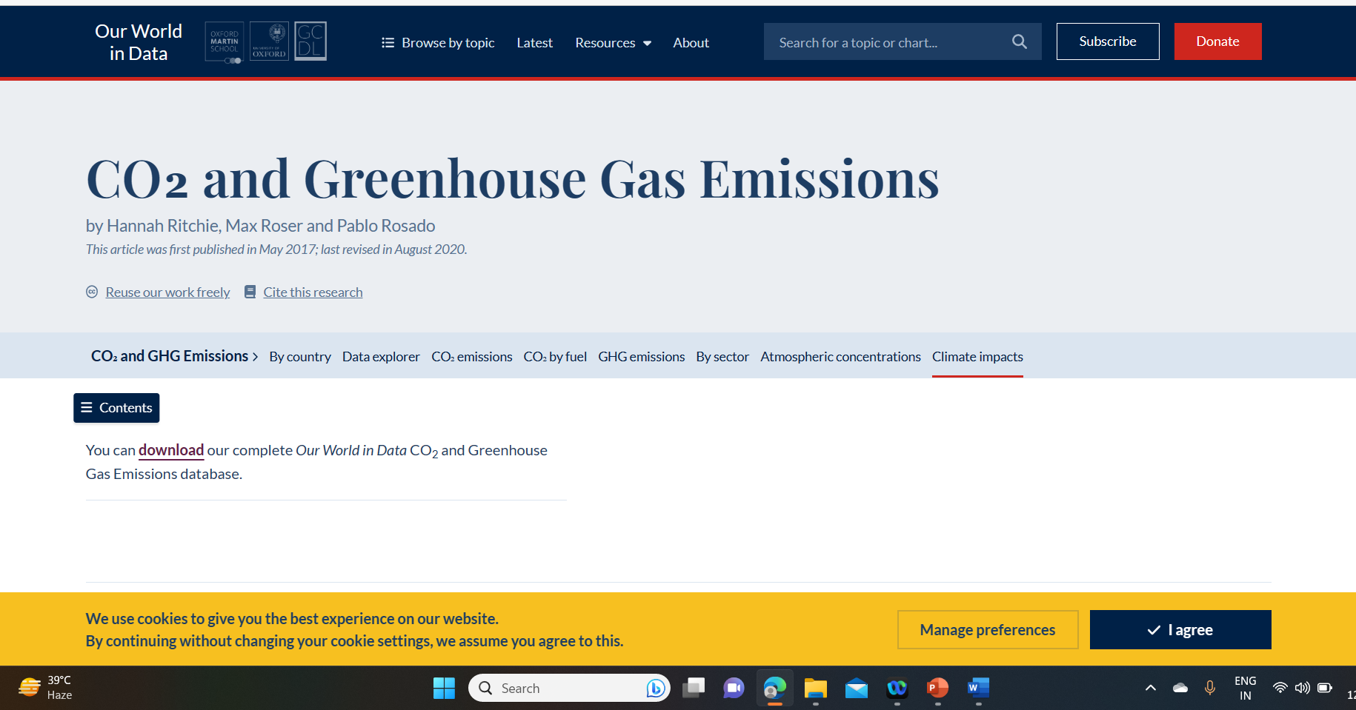
Towards ADAPTATION and MITIGATION
CO₂ and Greenhouse Gas Emissions - Our World in Data

Slide 29
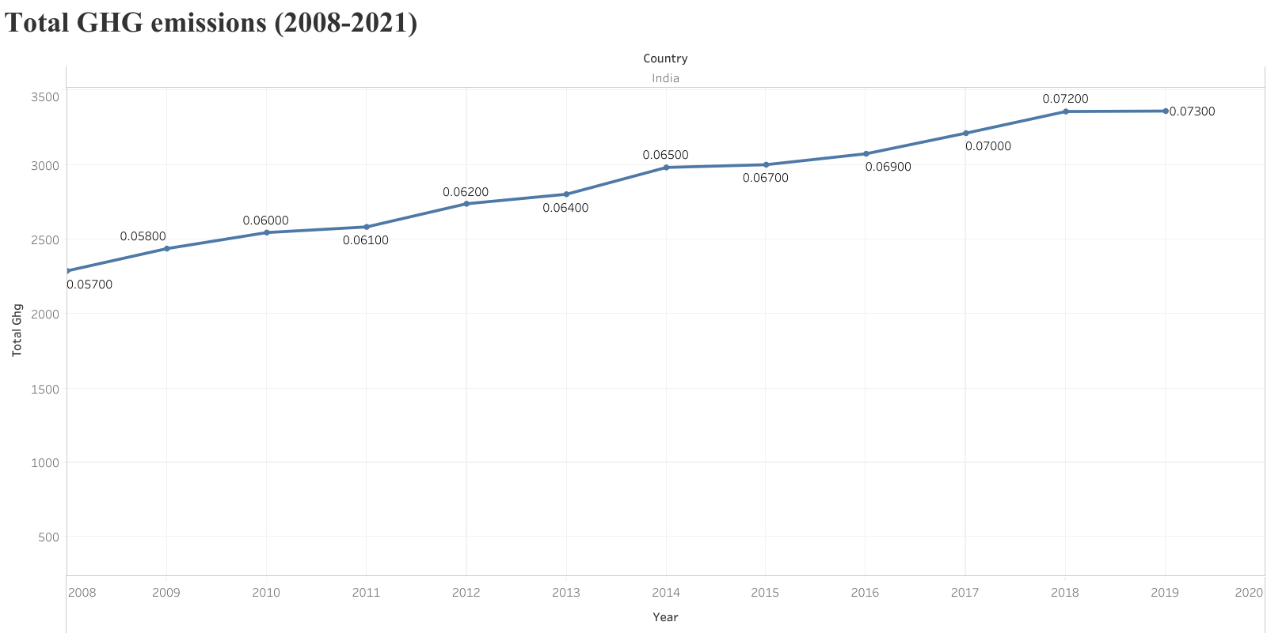
STATISTICS OF GHG EMISSIONS

Slide 30
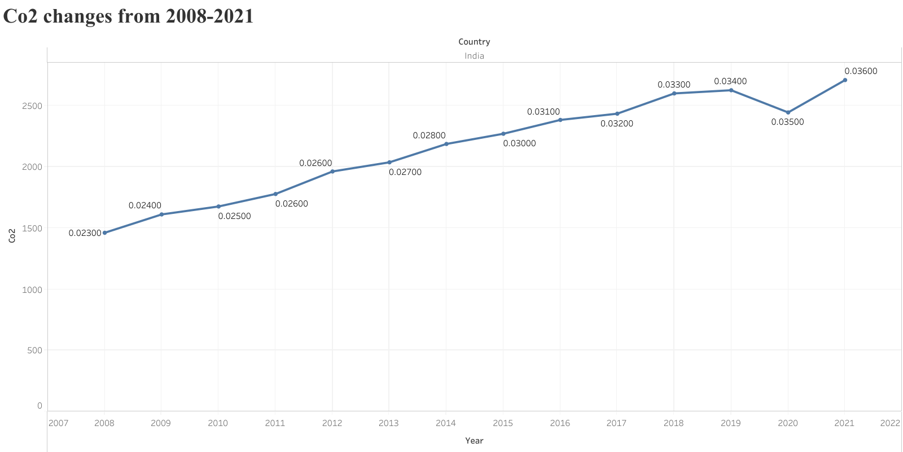
STATISTICS OF Co2 EMISSIONS

Slide 31
TOOLS EXPLORED FOR TEXT MINING, ANALYSIS AND VISUALIZATION OF IPCC CHAPTER
Chapter conversion PDF to HTML – PY4AMI
Keyword/key phrase extraction- corticol.io and RAKE, YAKE, genism
Dictionary creation:
- automatic abbreviated dictionary – Docanalysis
- manual dictionary
Text analysis and visualization- summarizer, voyant tools, word clouds, VOSviewer
Knowledge graphs: Obsidian, python

Slide 32


STEP 1
CONVERSION OF IPCC CHAPTERS (PDF’S) TO HTML FILES - PYAMI
< >
HTML
pyami
ipcc chapter 15

Slide 33
STEP 2: KEYWORD EXTRACTION
We extract keywords from the converted HTML files
1
keyword | score
financ | 0.25
doi | 0.25
climatic | 0.24
pdf | 0.19
Converted HTML
Extract keywords using different tools
< >
HTML
2
keyword | score
fuel | 2.76
facility | 2.69
springer | 2.66
bond | 2.66
1.Gensim
2.RAKE
3.YAKE
keyword | score
climate | 4.05
finance | 0.0001
financial | 0.0002
energy | 0.0002
3

Slide 34
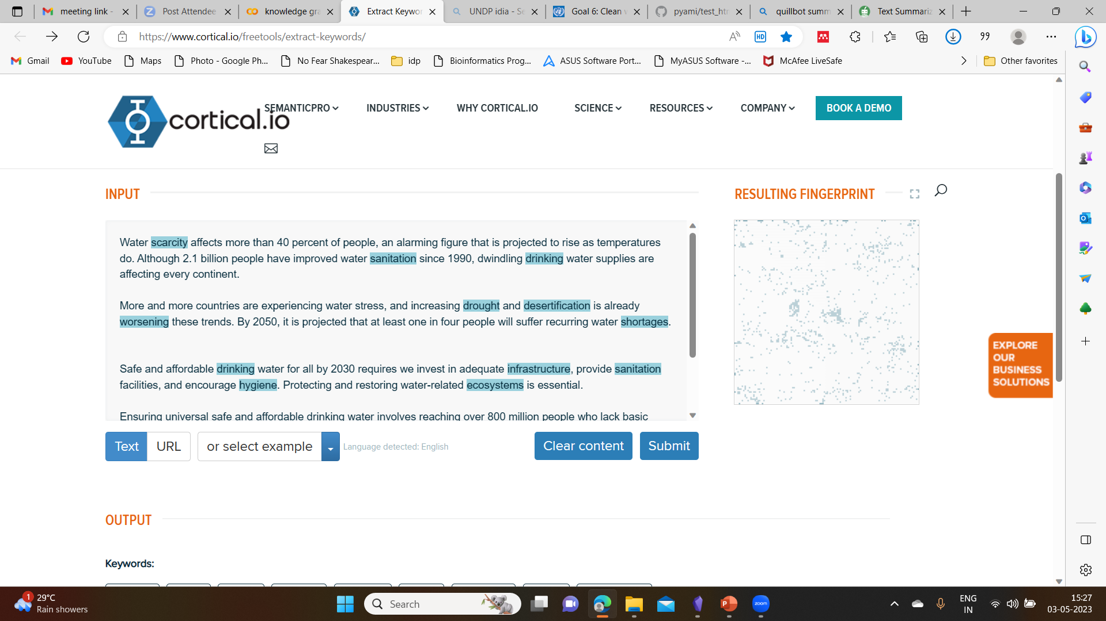
Keyword extraction tool – Cortical.io
Sector specific “water & sanitation”

Slide 35




STEP 3: AUTOMATED DICTIONARIES
CREATION OF ABBREVIATED DICTIONARIES - DOCANALYSIS
<dictionary title="abb_chapter15">
<entry name="SCF" term="Standing Committee on Finance">
<raw wikidataID="Q115097350, Q3421536"/> </entry>
pyami
Do analysis
Ipcc reports
<Html >
Generation of abbreviated dictionaries

Slide 36
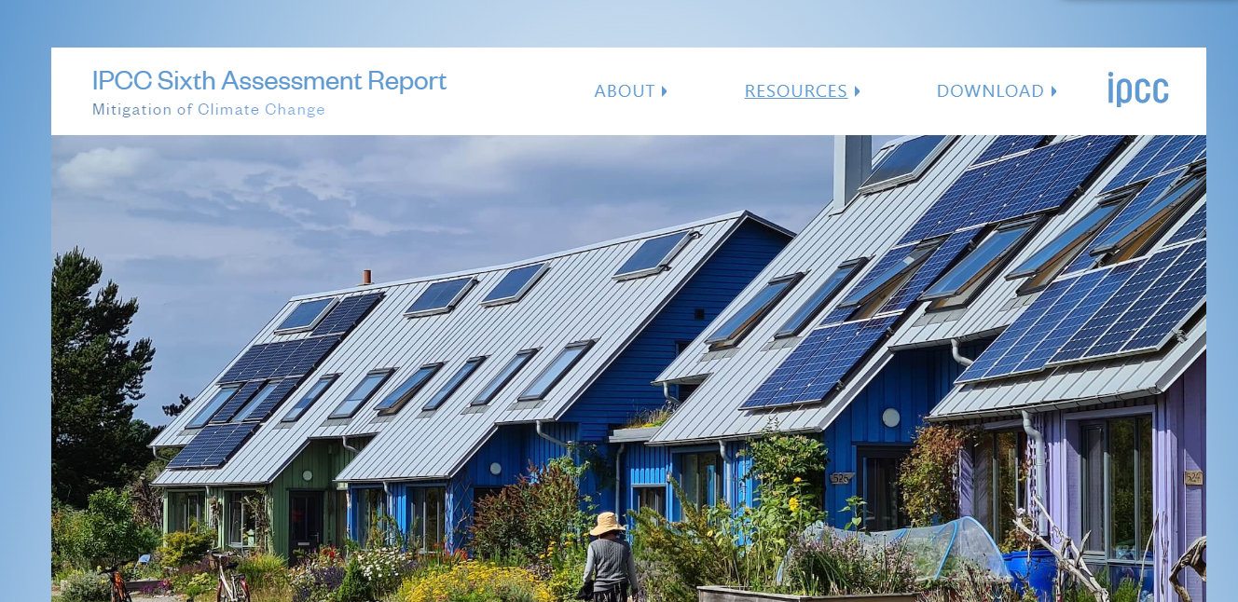

STEP 3: DICTIONARY CREATION
Set of terms with unique Wikidata Identifiers
<dictionary title="finance and investment" version="0.0.5">
<desc> manually created by Gayathri Jonnalagadda 2023-01-24 </desc>
<entry
term=“ capital“
wikidataID="Q1897397"
desc="money used by entrepreneurs and businesses to buy what they need to make their products or provide their services"/>
Manually created by reading the chapter

Slide 37
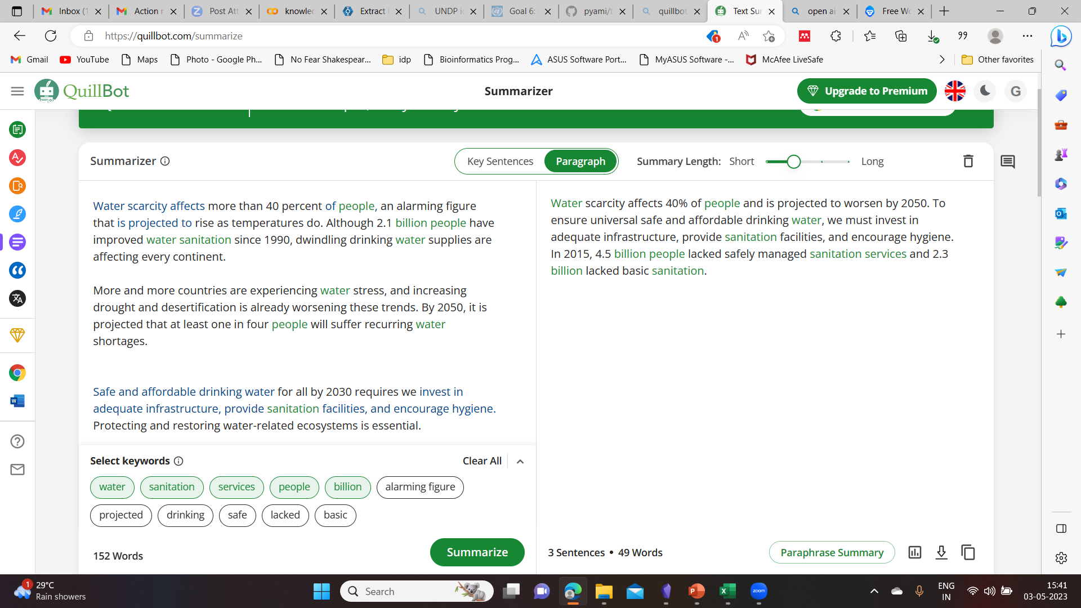
Text mining &visualization
Summarization- water & sanitation, UNDP
Although 2.1 billion people have improved water sanitation since 1990, dwindling drinking water supplies are affecting every continent.
More and more countries are experiencing water stress, and increasing drought and desertification is already worsening these trends.
By 2050, it is projected that at least one in four people will suffer recurring water shortages.
Safe and affordable drinking water for all by 2030 requires we invest in adequate infrastructure, provide sanitation facilities, and encourage hygiene.
Ensuring universal safe and affordable drinking water involves reaching over 800 million people who lack basic services and improving accessibility and safety of services for over two billion.
Also explored- Resoomer, intellippt, SMMRY, summarizer

Slide 38
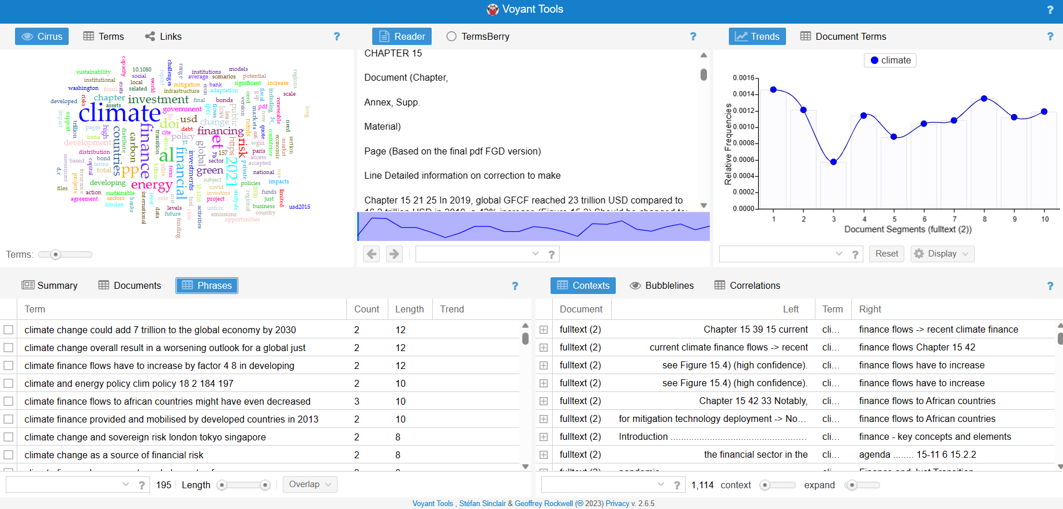
Text mining and visualization cont..
Voyant Tools 2.0 (Corpus View))
From text analysis portal for research

Slide 39
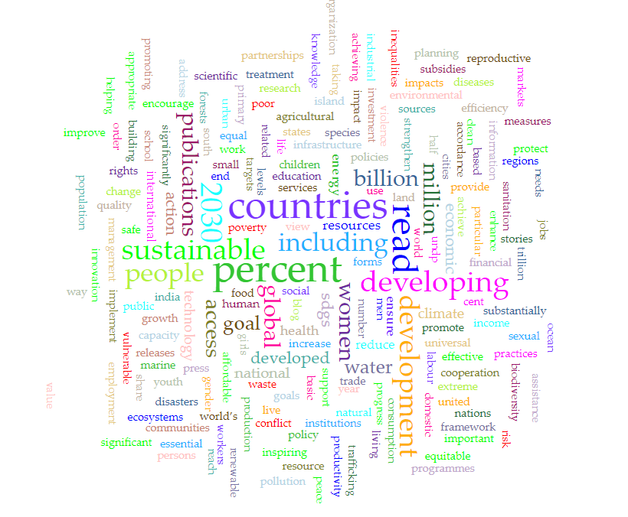
Text visualization cont..
Input data
Web of science: ‘Climate related development India’ – 1K papers
Title, author, abstract
Tool used: Voyant Tools 2.0 (Corpus View))

Slide 40
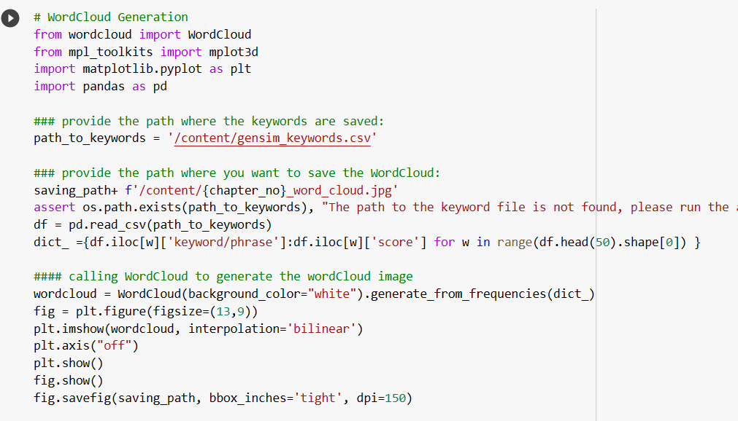
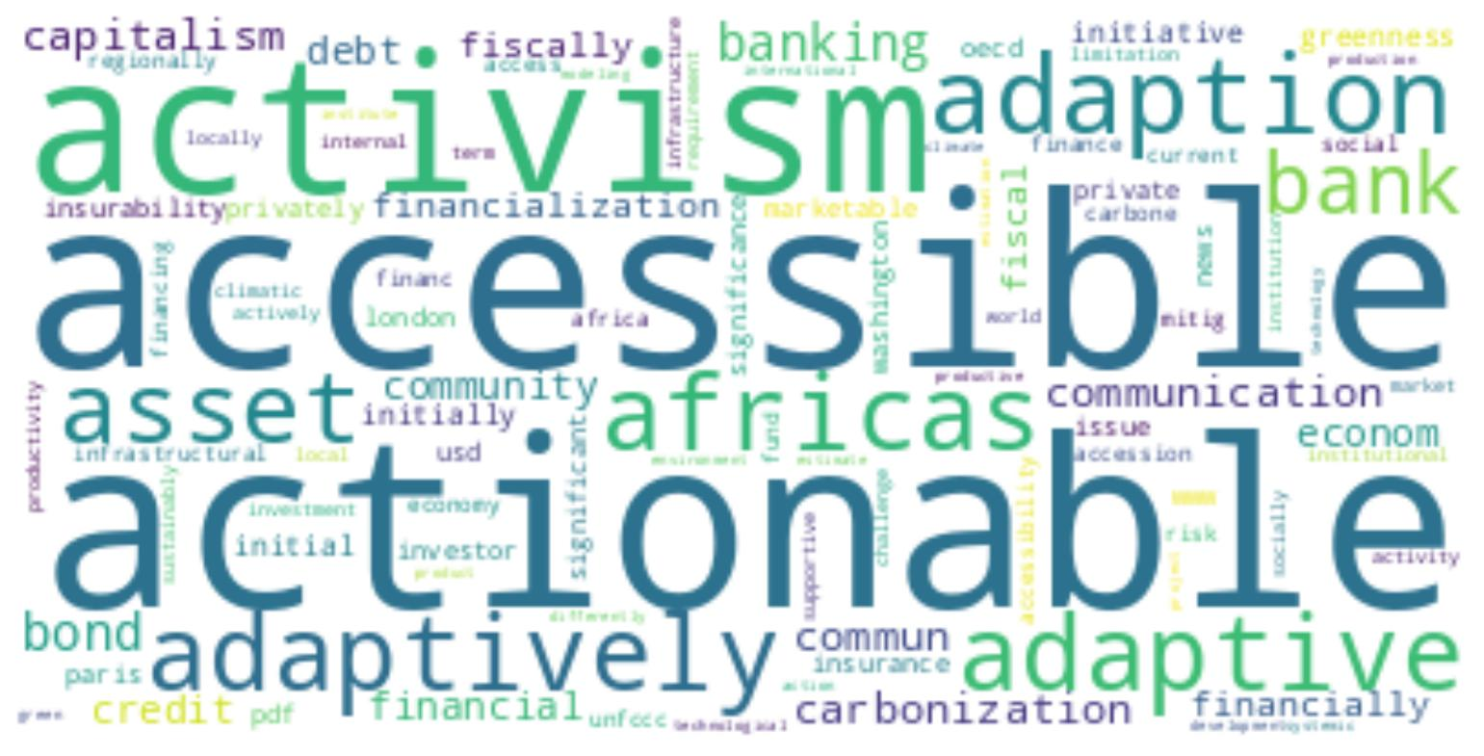
Word cloud from chapter15 “Finance & Investment”
Using keywords extracted using gensim
Python code for word cloud generation

Slide 41
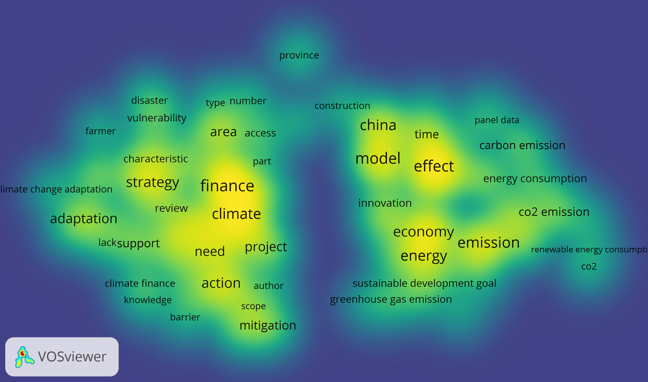
VOS viewer
Text visualization cont..
Input data
Web of science: ‘Climate related development India’ – 1K papers
Density visualization

Slide 42
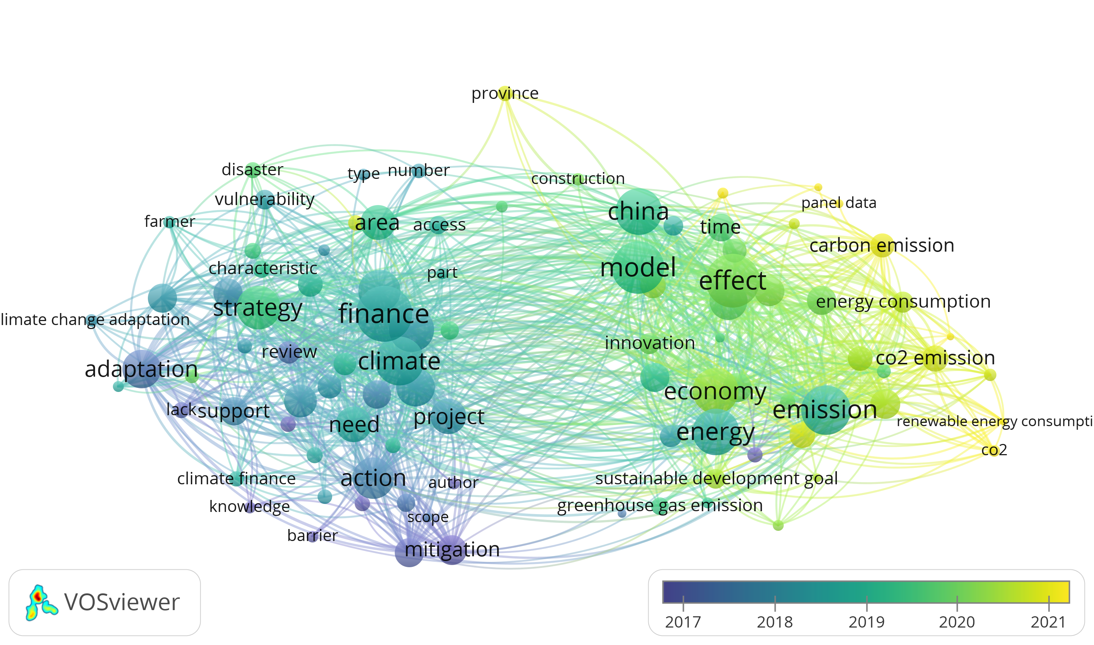
Text visualization cont..
Overlay visualization
VOSviewer

Slide 43
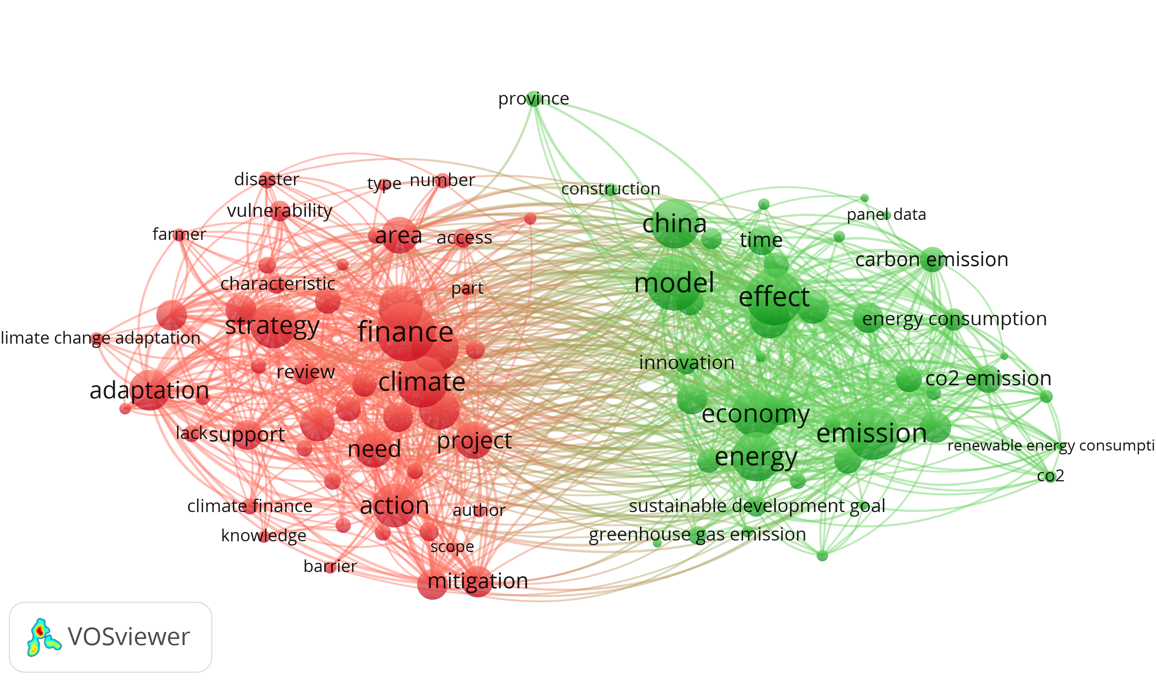
VOSviewer
Text visualization cont..
Network visualization

Slide 44
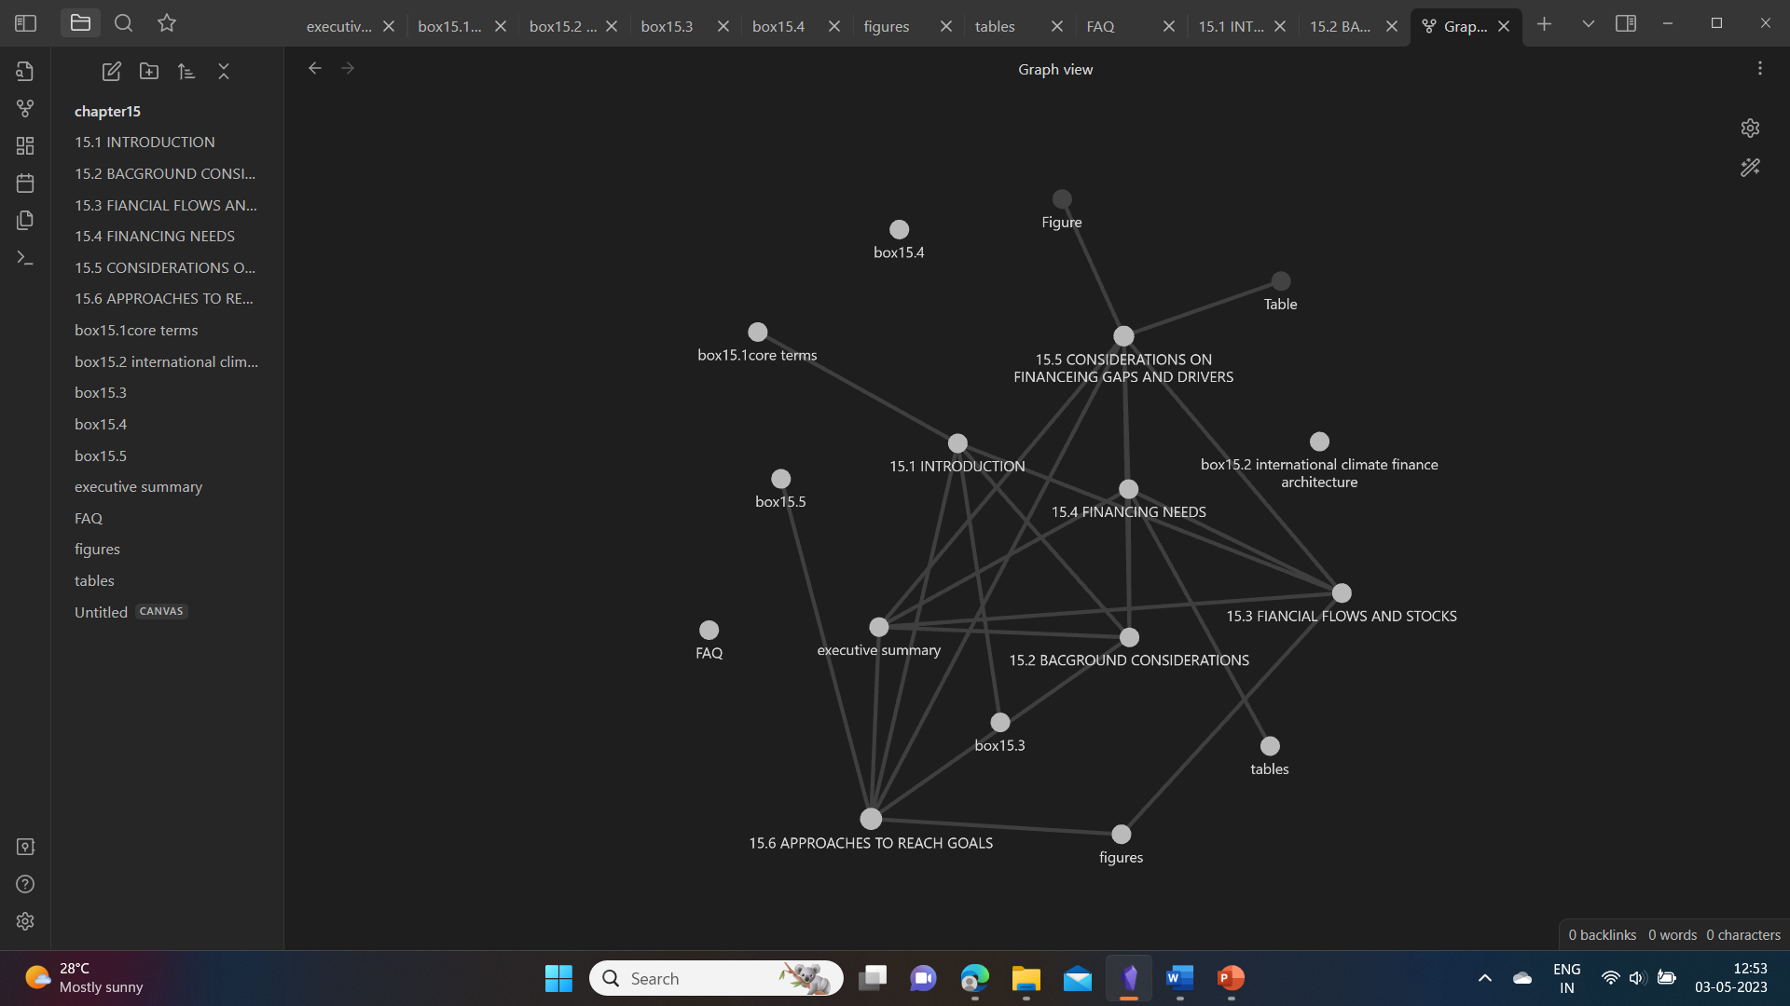
KNOWLEDGE GRAPHS
knowledge graphs is a digital structure that represents knowledge as concepts and the relationships between them.
Knowledge graph using Obsidian
Works on markdown files
Note-making software.
Nodes-Node connection.

Slide 45
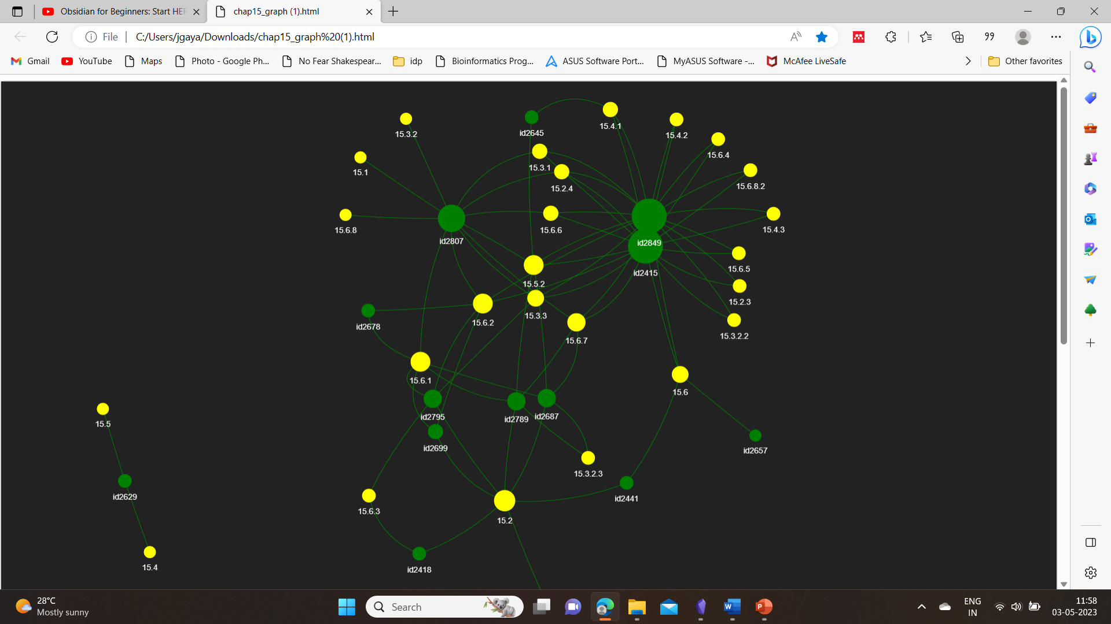
Knowledge graph using python

Slide 46
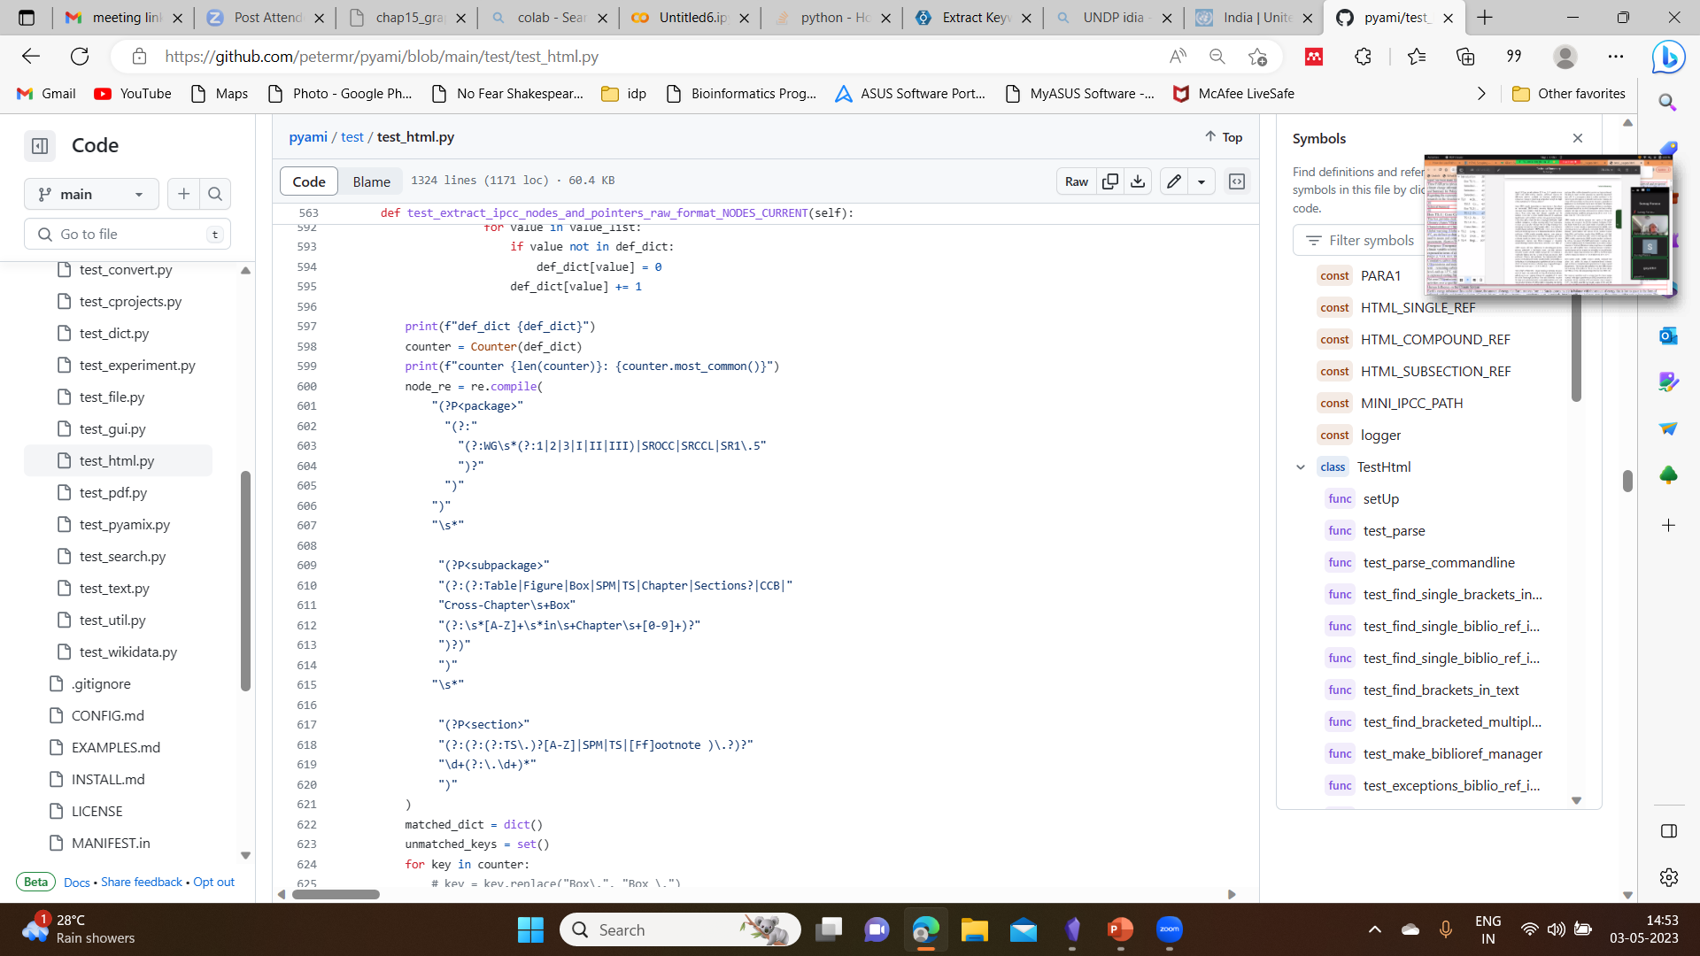
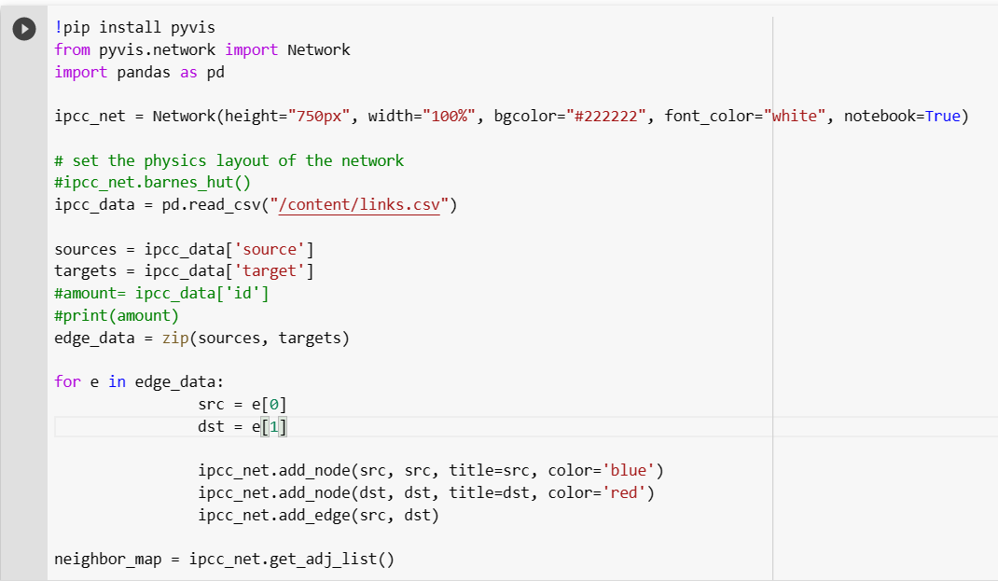
Python code to extract the edges
Python code to build a knowledge graph
By PMR
Test_html.py
By Shweata N. Hegde

Slide 47
Future Prospects
linking the analysed data into chapter knowledge graph.
Working on the wikibase for climate knowledge.
Improving, adding new features and optimising the tool Py4ami.

Slide 48
THANK YOU

